Slide 1

COVID-19
Exploring the impacts of COVID-19 in Australia
By GROUP 2 – ISHAAN NIGAM, Namita sahoo, Pooja gupta and Sam Portelli

Slide 2
Exploring the impacts of COVID-19 in Australia
COVID-19 has significantly impacted people, health, businesses, industries, unemployment, workers and international trade over the last couple of years.
This project explores the impacts of coronavirus (COVID-19) in Australia in the following key areas:
Economy/ Business
Unemployment
International Trade
Health/ People

Slide 3
Scope of the project includes:
Extracting COVID-19 Infections/ cases, Business, Unemployment, Health and International trade related data available for Australia – Primary data resources are
Australian Bureau of Statistics
Reserve Bank of Australia
Australian Institute of Health and Welfare
NSW Ministry of Health and Coroner’s Court of Victoria
World Health organisation
Preparing and Cleaning extracted data for the analysis
Trimming to remove report headers and comments
Formatting into usable time series (Yearly, Quarterly, Monthly, Weekly)
Merging COVID-19 Infection cases and Key measures for correlation analysis
Analysing data for impacts of COVID-19 in key areas identified
Visualising our analysis and summarizing the findings
Plotting charts/ graphs (Bar, Pie, Line, Scatter, Boxplot, Line Regression, Correlation tests) using Matplotlib libraries

Slide 4
Hypotheses of the project includes:
We expected to see an overall change in the following due to the pandemic.
Health:
Increased reported cases of suicides,
Increased use of crisis hotlines and
Increase in deaths
Unemployment:
Increased unemployment rates, including youth unemployment rate
International trade:
Business/ Economy:
Declined GDP and supply chain measures
Negative impact to Australian dollar trade-weighted Index
Decrease in Company Gross Operating Profits

Slide 5
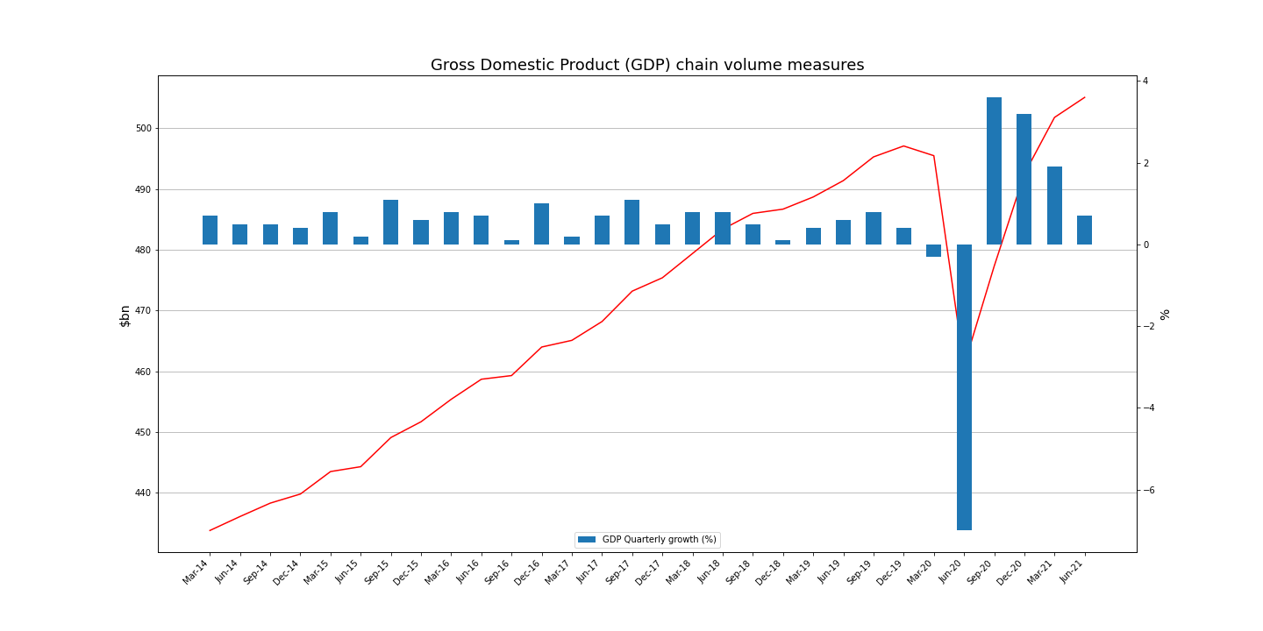
Impacts of COVID-19 on Australian - Business and Economy
Australian economy fell an unprecedented 7.0% in June'20 quarter

